Slide 1

AngularJS
Custom components

Slide 2
Understanding Components
Component is a special kind of directive that uses a simpler configuration
Advantages of Components
- simpler configuration than plain directives
- promote sane defaults and best practices
- optimized for component-based architecture
- writing component directives will make it easier to upgrade to Angular 2
When not to use Components
- for directives that need to perform actions in compile and pre-link functions
- when you need advanced directive definition options like priority, terminal, multi-element
- when you want a directive that is triggered by an attribute or CSS class

Slide 3
Creating and configuring a Component
Components can be registered using the .component() method
The method takes two arguments:
The name of the Component (as string).
The Component config object. (Note that, unlike the .directive() method, this method does not take a factory function.)
/!\ Components match only elements

Slide 4
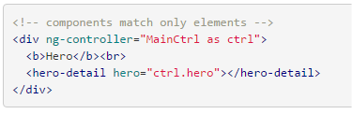
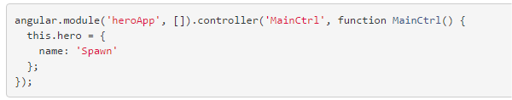

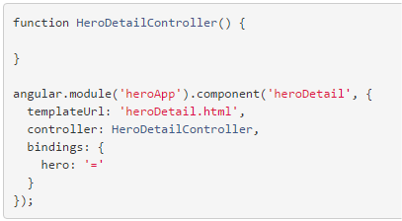
Creating and configuring a Component
index.html
index.js
heroDetail.js
heroDetail.html

Slide 5
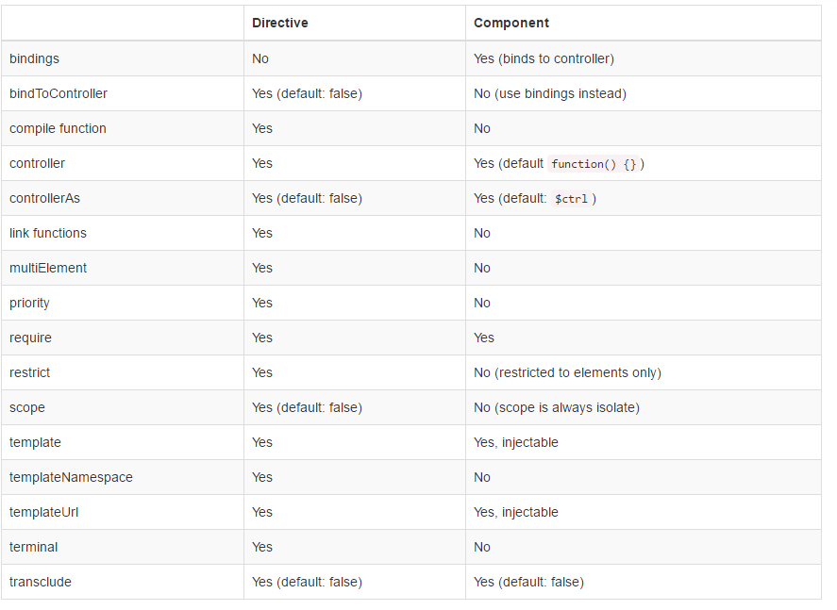
Comparison between Directive definition and Component definition

Slide 6
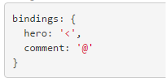
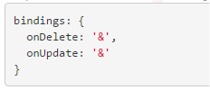
Component-based application architecture
Components only control their own View and Data
Components should never modify any data or DOM that is out of their own scope
Components have a well-defined public API - Inputs and Outputs
Inputs should be using < and @ bindings
< : one way binding (but beware….parent and component reference the same object)
@ : for string, especially when the value of the binding doesn't change.
Outputs are realized with & bindings, which function as callbacks to component events.

Slide 7

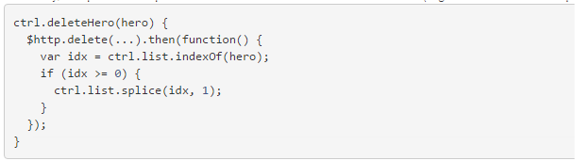
Component-based application architecture
Instead of manipulating Input Data, the component calls the correct Output Event with the changed data.
For a deletion, that means the component doesn't delete the hero itself, but sends it back to the owner component via the correct event.
That way, the parent component can decide what to do with the event (e.g. delete an item or update the properties)

